Slide 1
PC
Kollmorgen’s parts
Other system’s parts
Ethernet cable
Network Switch
EtherCAT network
Non-EtherCAT device
Non-EtherCAT device
PCMM
EtherCAT master
Future extensions
in
out
in
out
AKD servo driver
AKD servo driver
EtherCAT slave
EtherCAT slave
Power
cable
Feedback
cable
Power
cable
Feedback
cable
Servo motor 1
Servo motor 2
First belt actuator
Second belt actuator

Slide 2
Antenna
Antenna
Frame with the sample under test
Trolley
Trolley
Kollmorgen servomotor 1
Belt actuators for the horizontal displacement of the antennas
Kollmorgen servomotor 2

Slide 3
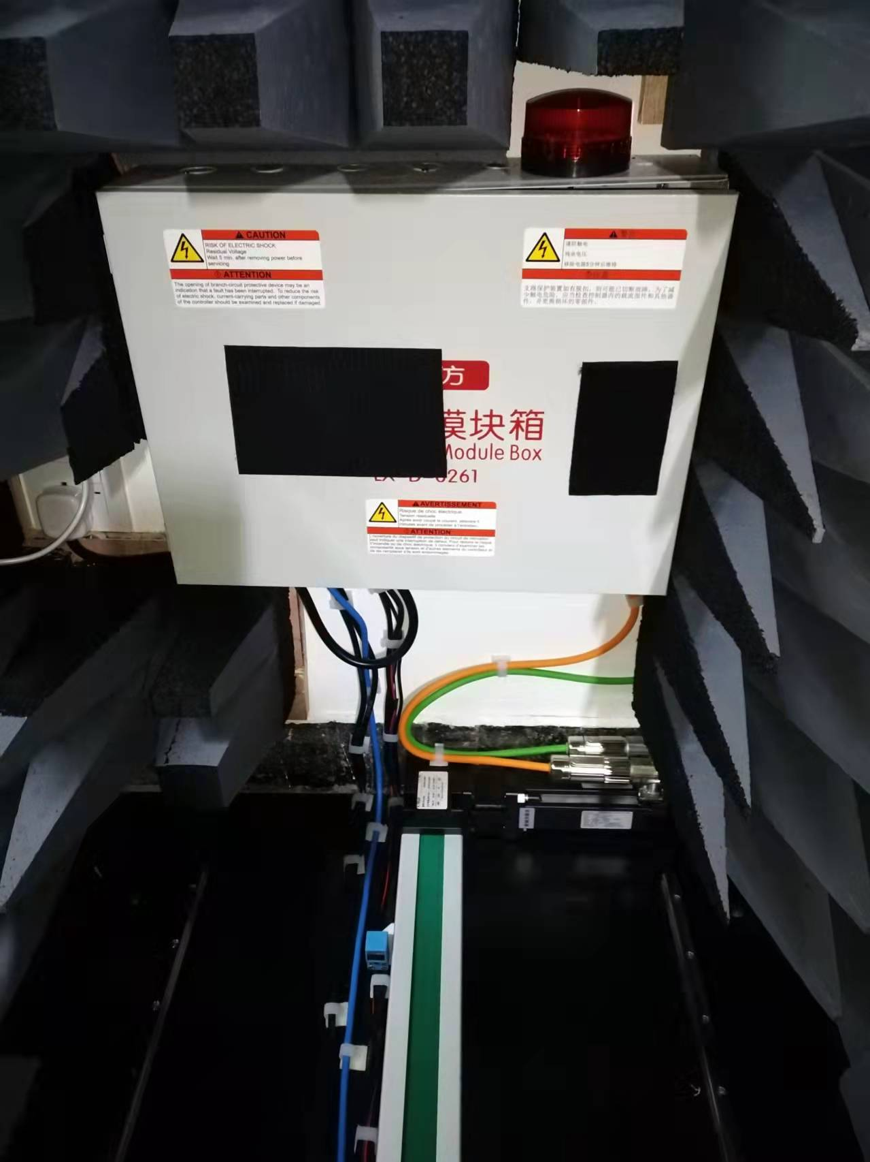
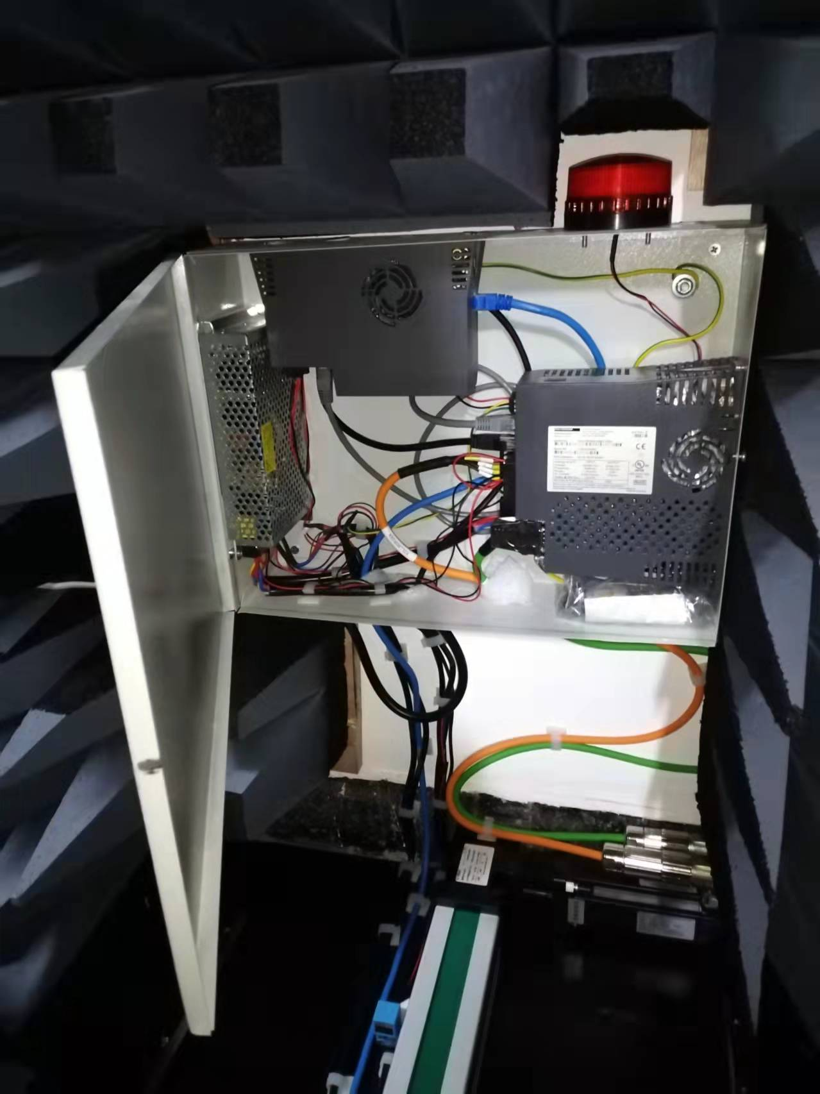
Motor ON
24 DC
Power
Supply
PCMM
AKD1
Servo-motor:
Power cable
Feedback cable
Proximity
sensor
LAN from PC
Belt actuator

Slide 4
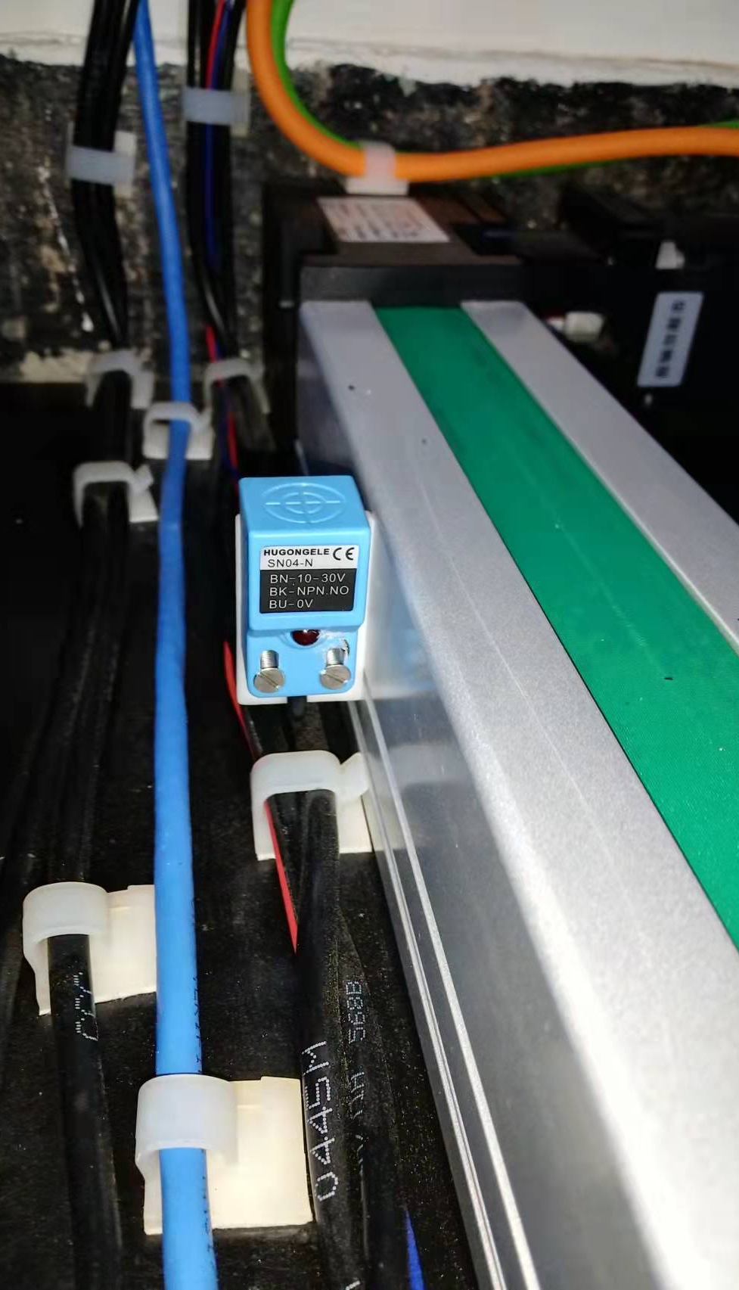
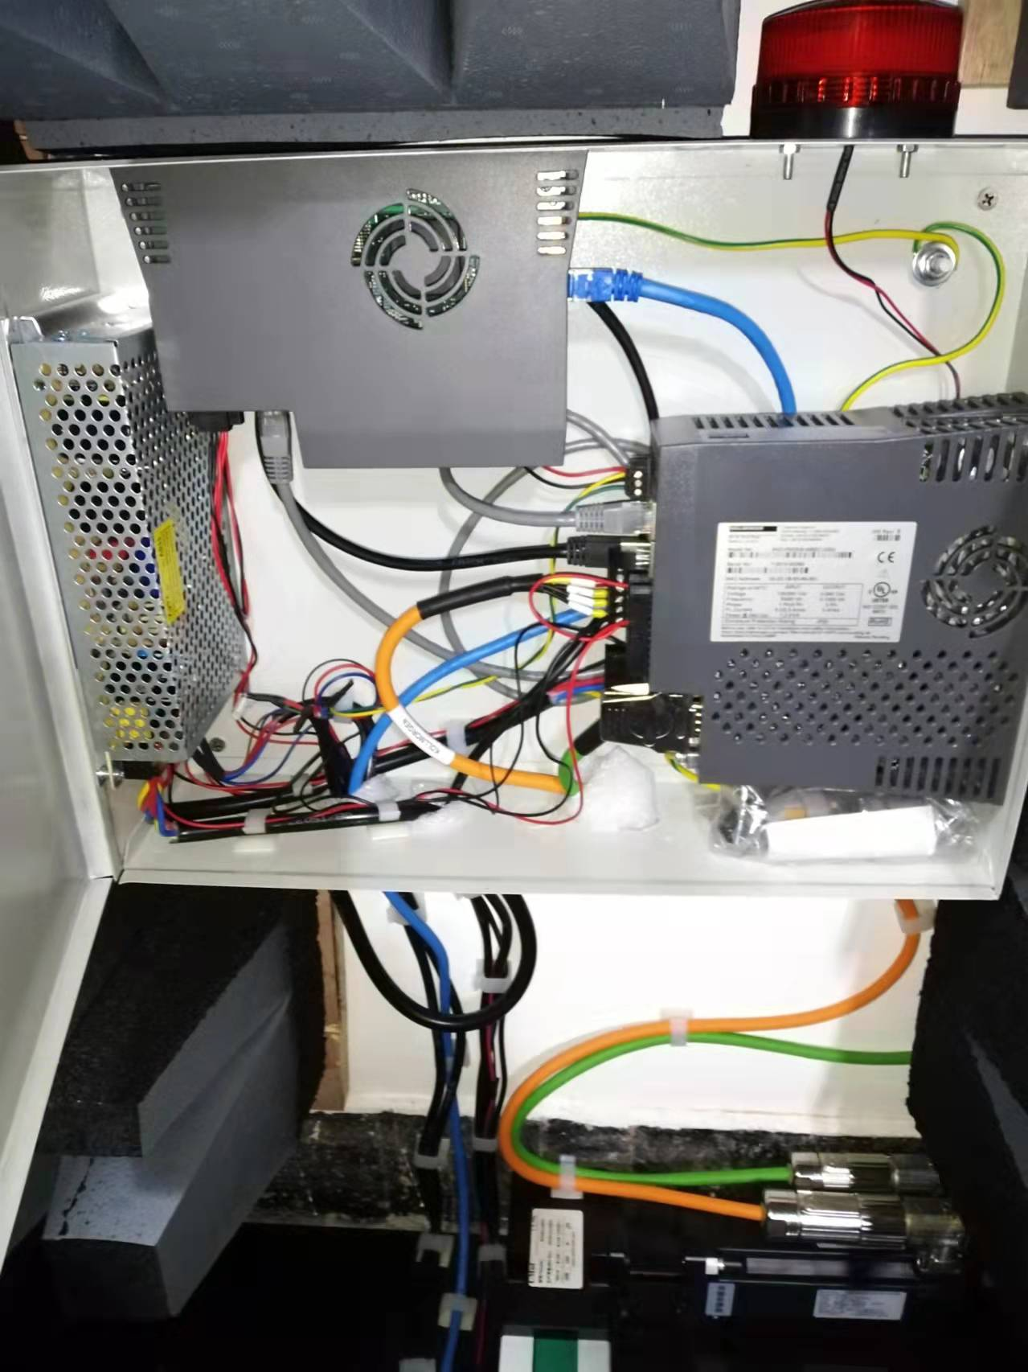
EtherCAT network:
PCMM + AKD1 + AKD2
PCMM
LAN to AKD1
AKD1
24 DC
Power
Supply
LAN from AKD1
to AKD2

Slide 5
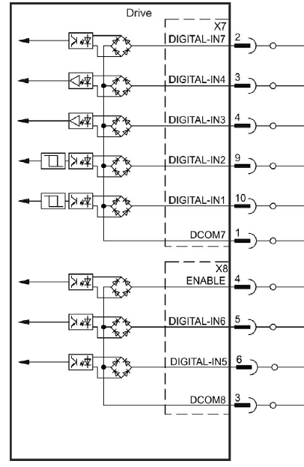
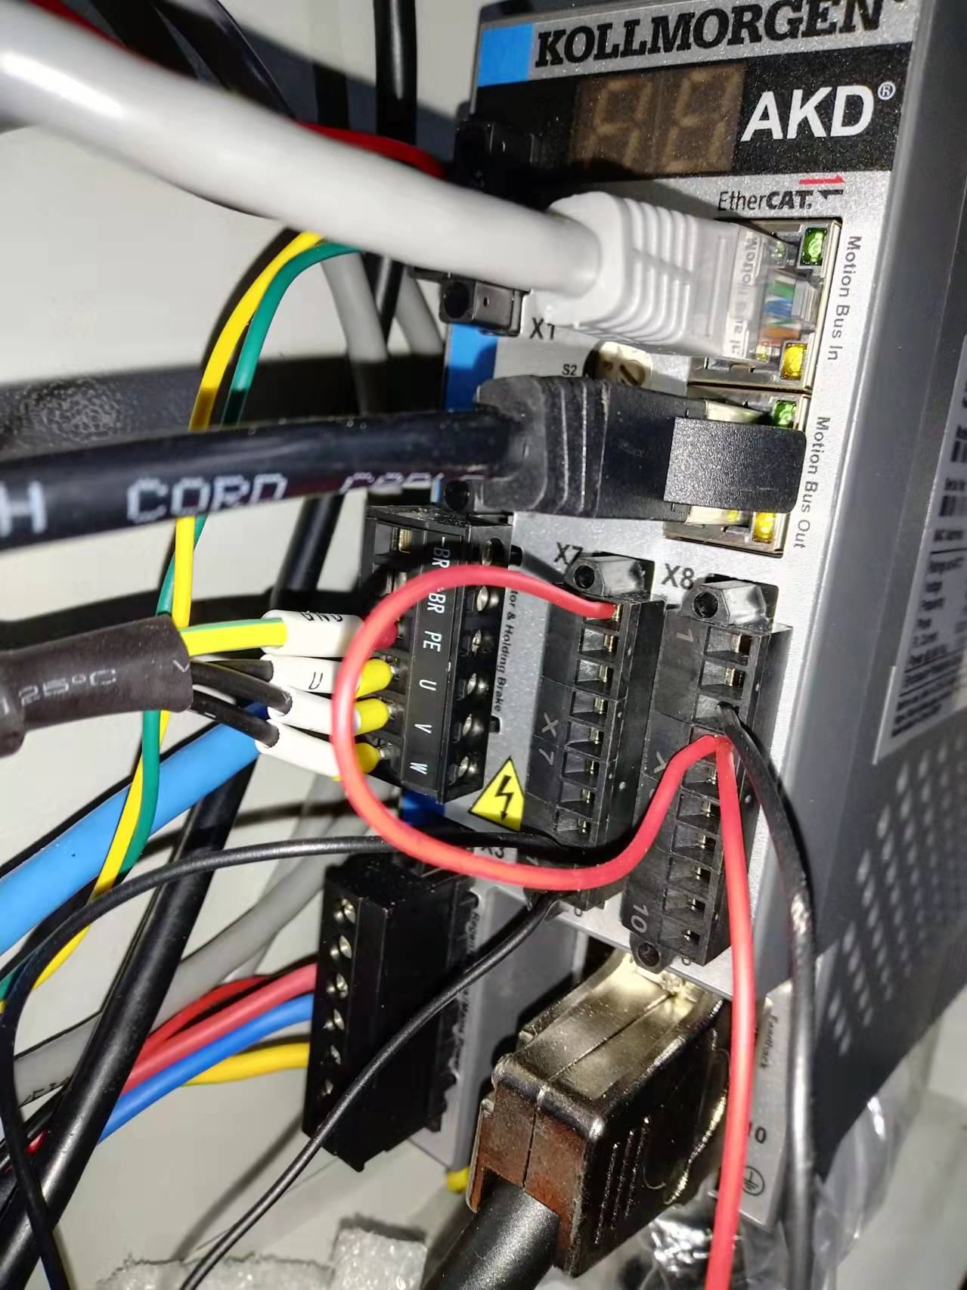
AKD X7 & X8 Digital Inputs
X7: sink connection
→AKD1
Ground by the proximity sensors
X7 pins 9, 10
←AKD2
Pins 9, 10:
Quick Stop
X7 pin 1
X8 pin 4
X8 pin 3
+24 V power source
by the micro-switches
Ground
X8: source connection

Slide 6
